Slide 1
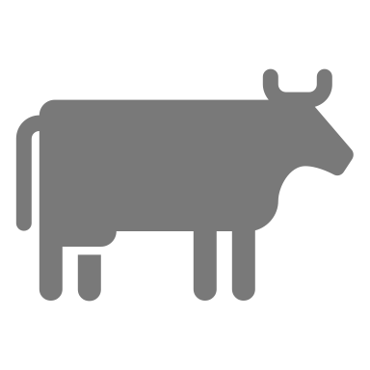
Shelley Tang
17407562
Multivariate Data Analysis on Milk Samples

Slide 2
AGENDA
Data Visualisation and Exploration on Protein Traits and Technological Traits
Clustering analysis on Milk Samples assessed by MIR Spectra wavelengths
Classification of Milk Samples

Slide 3
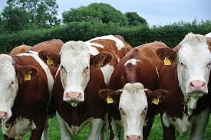
OVERVIEW OF THE DATA
430 observations and 582 variables
Characteristics of the cow and its milk
14 Individual Traits
MIR Spectra of different wavelengths measured in cm^(-1)
Spectral values are the absorbance rates, measured in log 10 of the reciprocal of the transmittance value

Slide 4
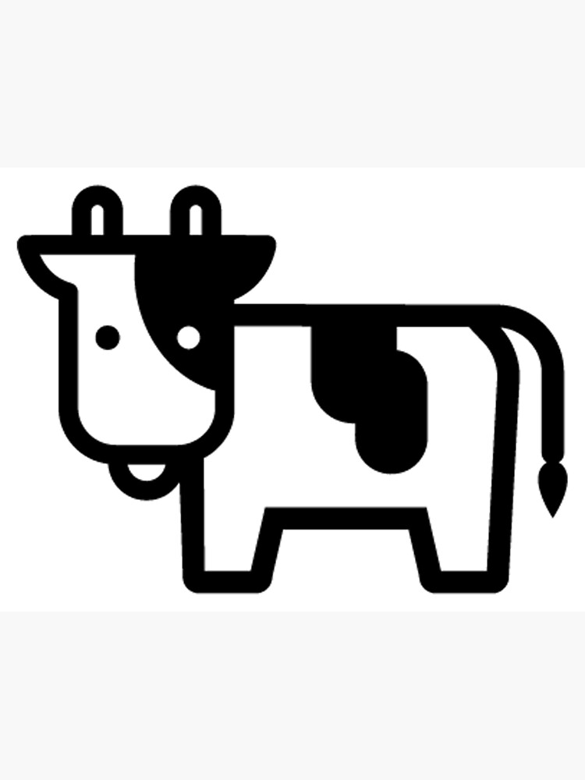
Section 1: Data Visualisation and Exploration

Slide 5
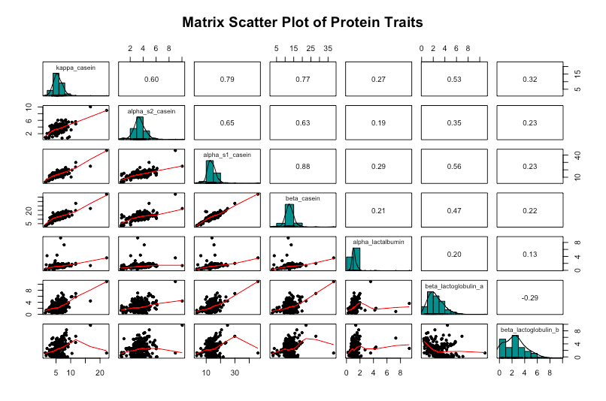
PROTEIN TRAITS
124 missing values- removed from dataset
Positive relationships between protein traits except Beta Lactoglobulin A and Beta Lactoglobulin B
7 Outliers were removed from the dataset

Slide 6
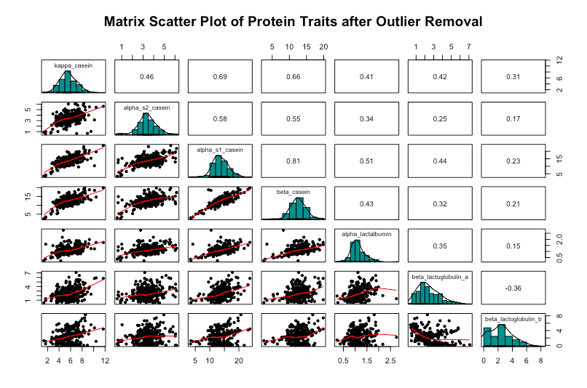

Slide 7
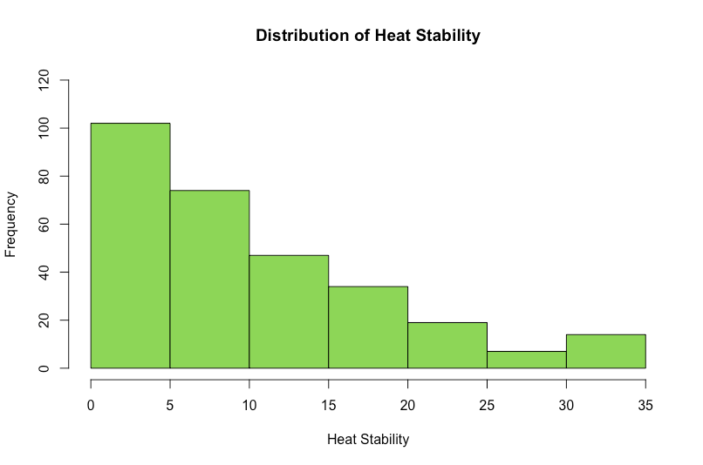
TECHNOLOGICAL TRAITS
No missing values
Right skewed
Milk can handle heat up to 30 minutes
Milk samples with heat stability over 30 minutes are discarded

Slide 8
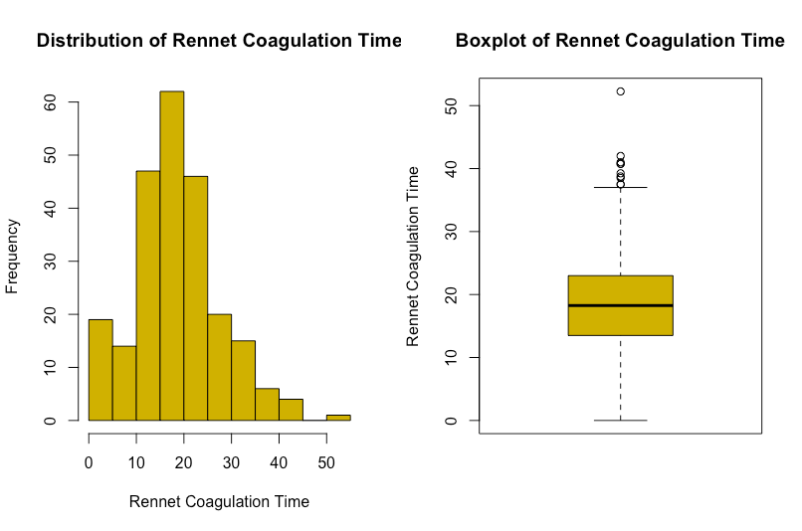
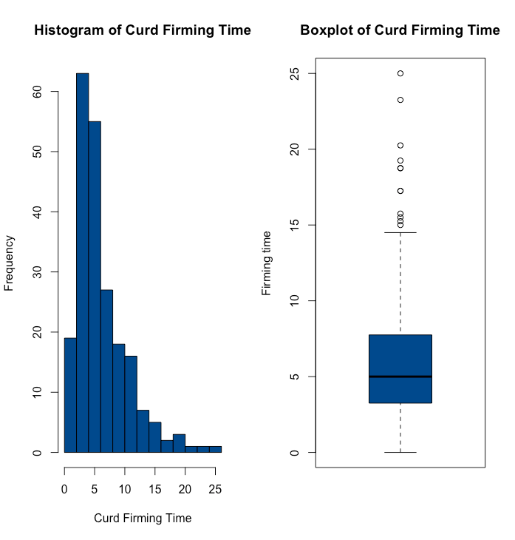
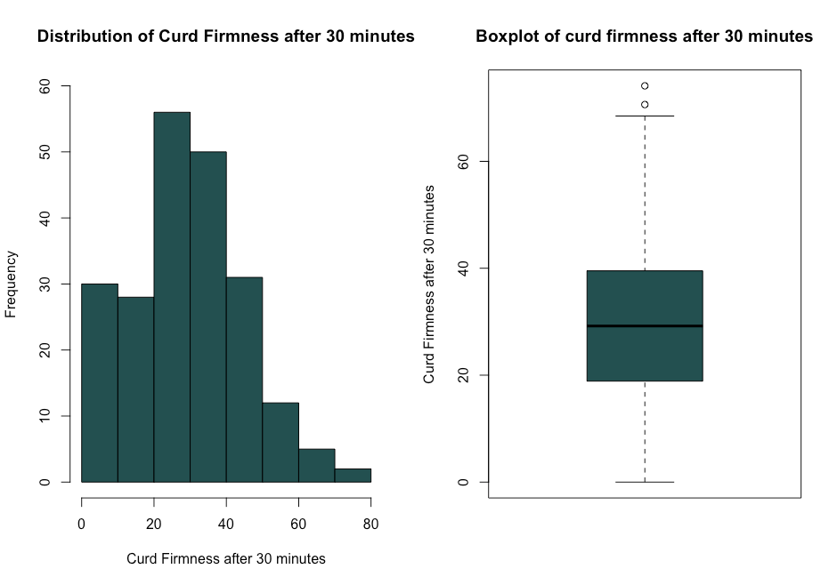
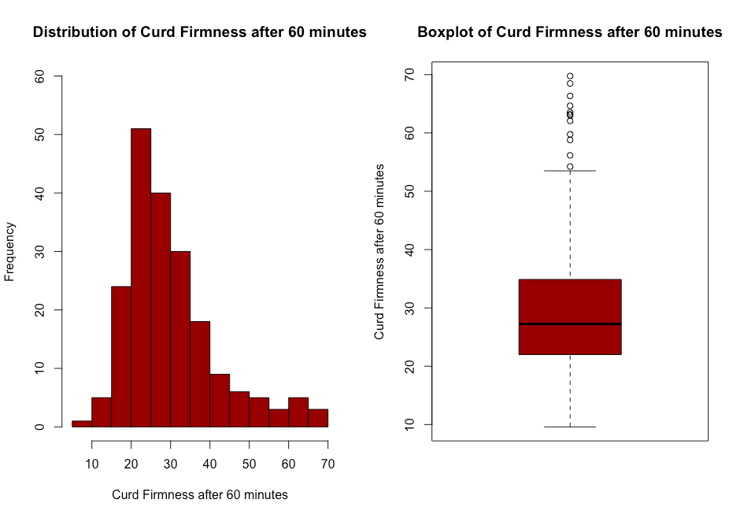
TECHNOLOGICAL TRAITS
Missing values are firstly discarded
Outliers are removed from the analysis
Curd firmness after 30 minutes of zero are discarded
RCT, k20 and a30 of zero are removed from the analysis

Slide 9
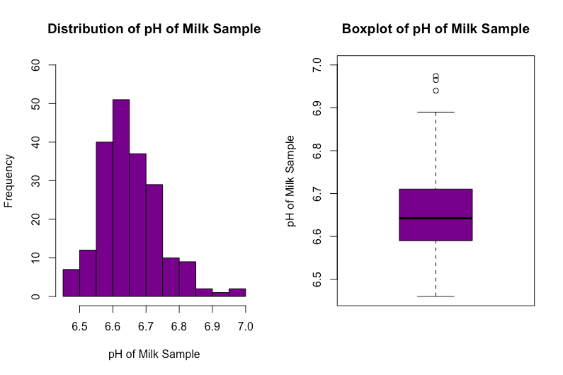
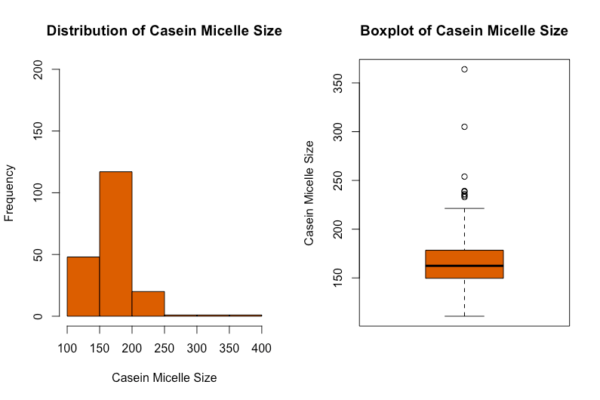
TECHNOLOGICAL TRAITS
One missing value: filled with average pH of 6.7
pH ranges from 6.46 to 6.974 in this data
In theory, ranges from 6.5 to 6.9
pH over 6.95 are discarded
Six observations with Casein Micelle size of over a 1000, assumed that there was an error in recording the data since size is usually 50-600mm in diameter
Scaled observations with Casein Micelle size of over 1000

Slide 10
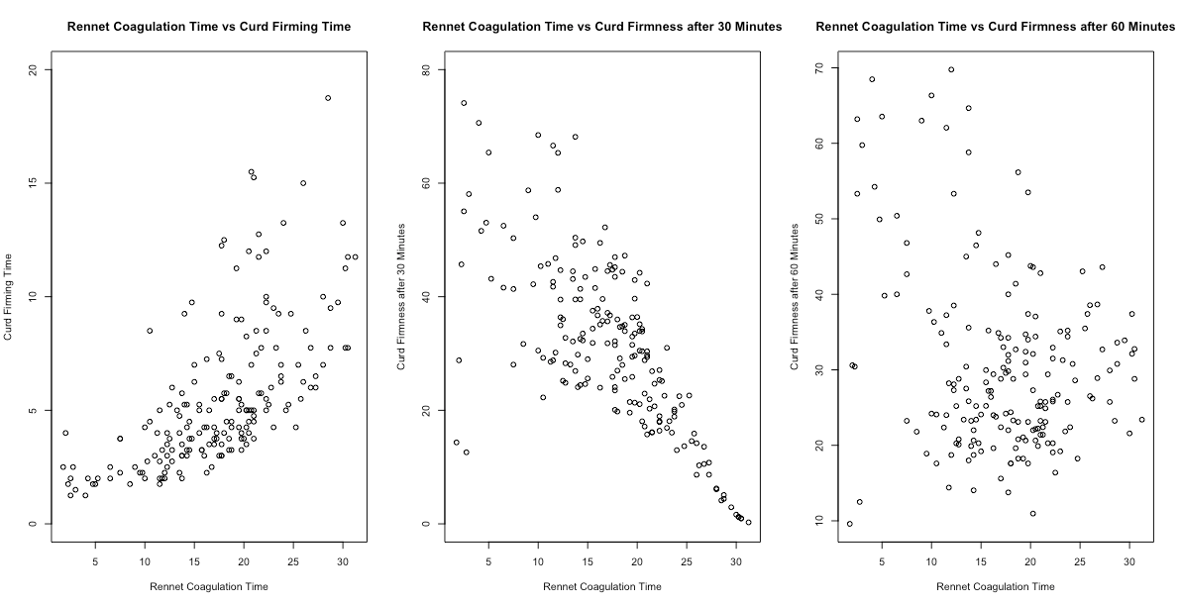
TECHNOLOGICAL TRAITS-RELATIONSHIPS
Determine the relationship between RCT and other milk coagulation properties (k20, a30, a60)
Positive relationship between RCT and k20
Negative relationship between RCT and a30
Weak relationship between RCT and a60
Notes:
Corr of RCT and k20: 0.64 significant p-values less than 0.05
Corr of RCT and a30: -0.72 significant
Corr of RCT and a60: -0.26 significant

Slide 11
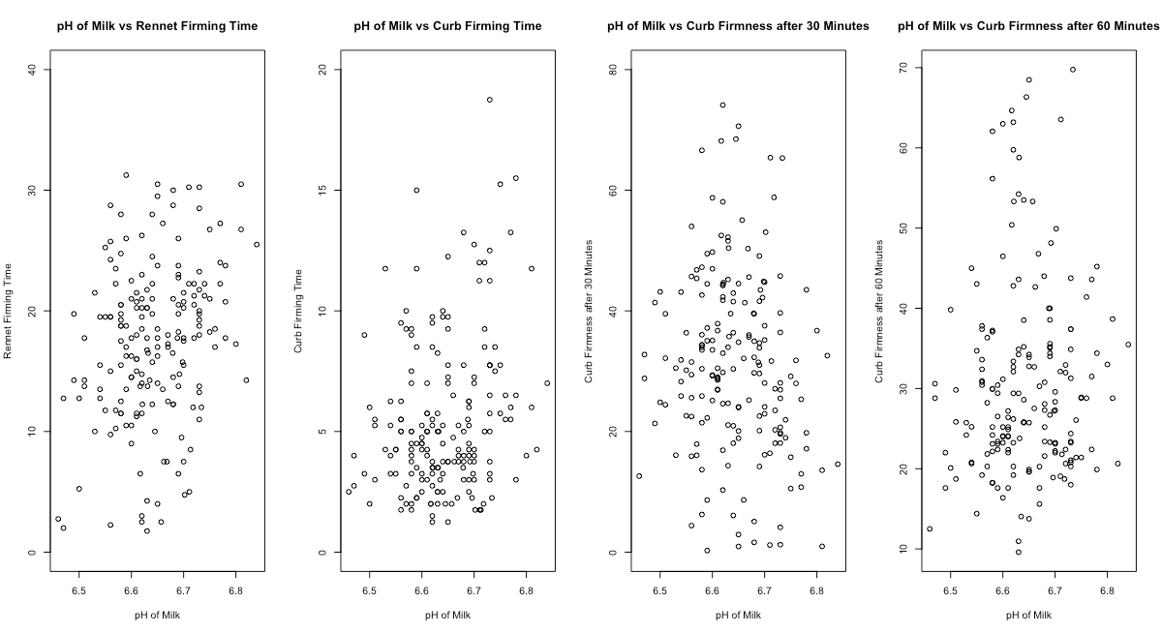
TECHNOLOGICAL TRAITS-RELATIONSHIPS
Milk with lower pH tend to coagulate more quickly
Interested in the relationship between pH of milk and milk coagulation properties
Weak relationships do not but are significant
No significant relationship between pH of Milk and a60
Notes:
Ph and rct: 0.2557767 significant p-value less than 0.05
Ph and k20: 0.2350488 significant
Ph and a30: -0.1374075 significant
Ph and a60: 0.07892281 insignificant no relationship

Slide 12
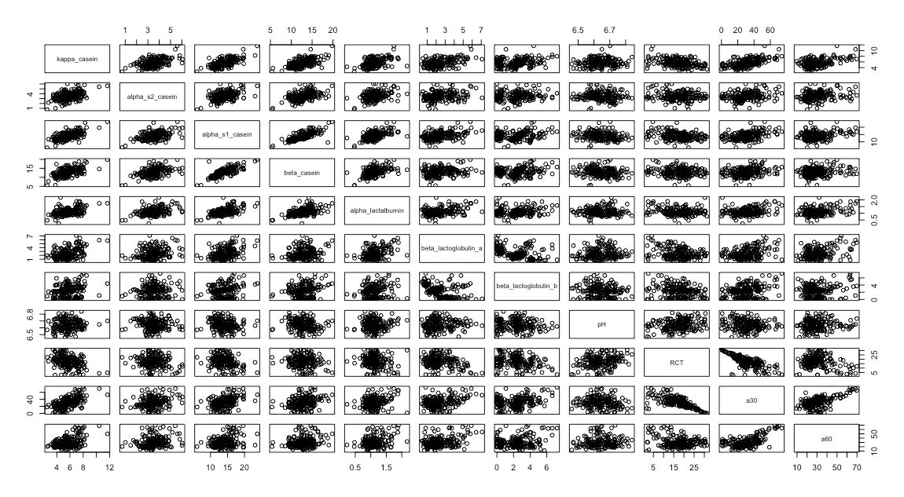
PROTEIN AND TECHNOLOGICAL TRAITS
No significant relationship between pH and protein traits
Significant negative relationship between rennet coagulation time and alpha lactoglobulin a and b
No significant relationship between RCT and alpha s2 casein, and RCT and beta casein
Significant relationships between a30 and protein traits, ranging from moderate to moderate strong correlations
Notes:
data$RCT, data$beta_lactoglobulin_a -0.2851687 significant
data$RCT, data$beta_lactoglobulin_b -0.2174149 significant
data$RCT,data$kappa_casein -0.3828091
data$RCT,data$alpha_s1_casein -0.2888449

Slide 13
Section 2: Clustering Analysis

Slide 14
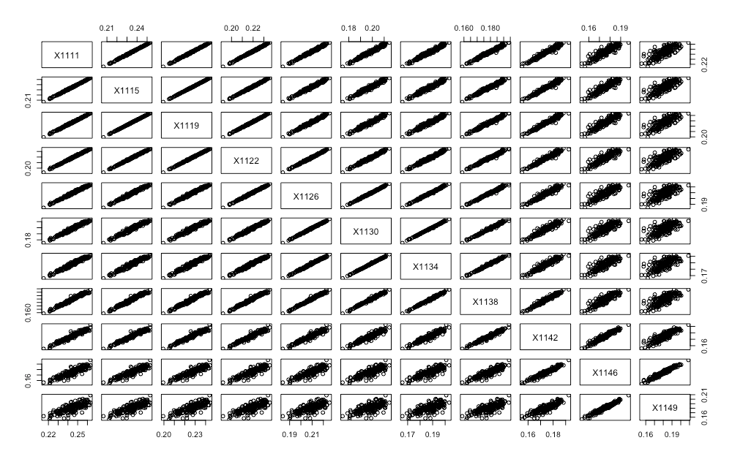
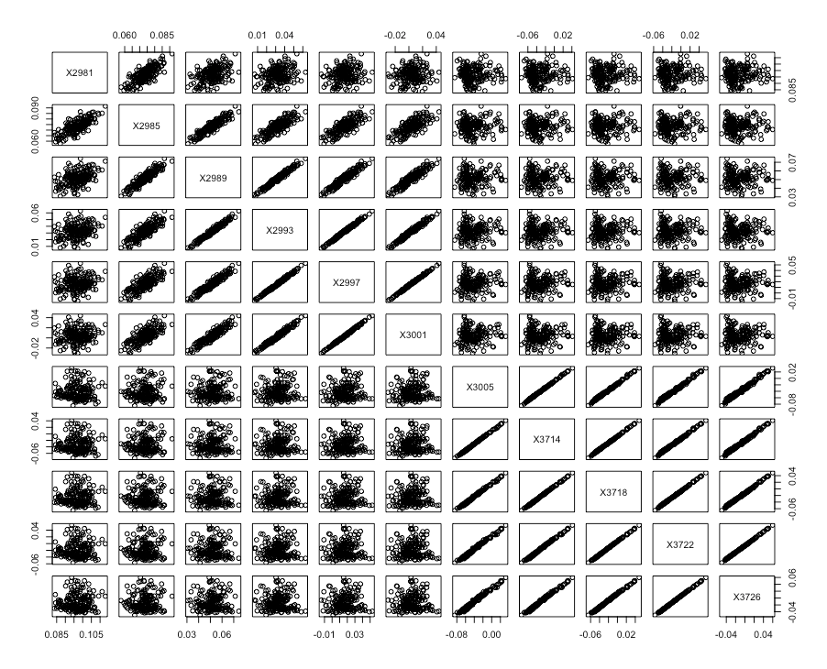
VISUALISATION OF DIFFERENT MIR SPECTRA WAVELENGTHS

Slide 15
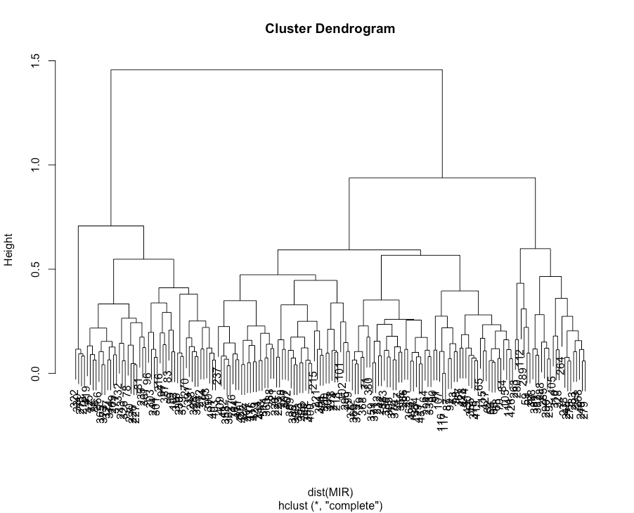
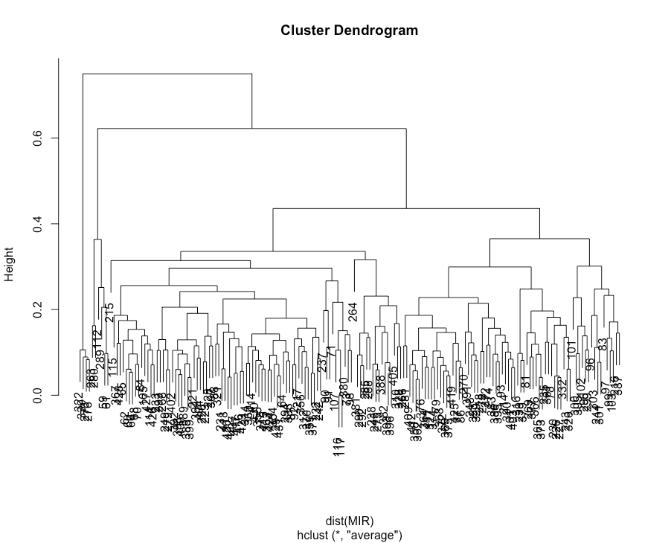
HIERARCHICAL CLUSTERING
Hierarchical Clustering is used as an exploratory tool for clustering
Tree like structure- dendrogram
Height represents the distance of dissimilarity between groups
2 linkage methods
Complete
Average
Complete: Two different groups
Average: Two different groups and three different groups

Slide 16
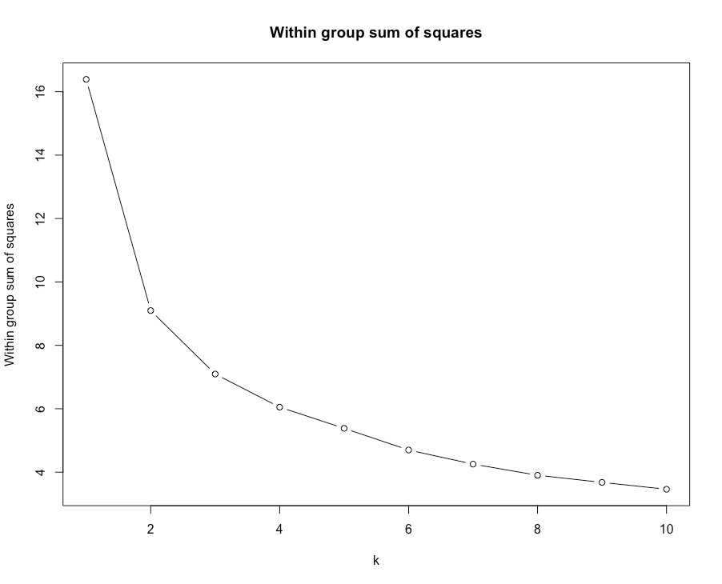
K-MEANS CLUSTERING ALGORITHM
K-means algorithm is an iterative clustering algorithm
K disjoint groups: observations within the same group are similar but are different from ones in different clusters
Aim: minimise within group sum of squares
The smaller the WGSS, the higher the number of clusters
Solution: choose K by looking for elbow effect in the graph -> K=2
Notes:
Discuss what is K-means clustering
Summarise how it works
WGSS

Slide 17
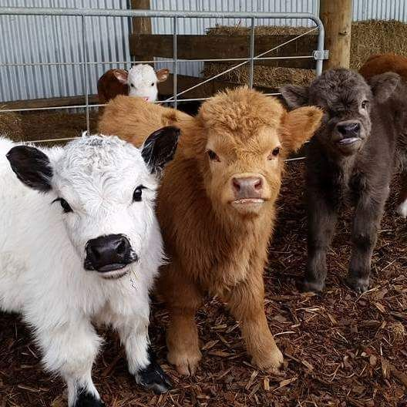
CLUSTERING RESULTS AND VALIDATION
Both clustering methods suggest that K=2 is the optimal number of clusters for milk samples
Interested to see how much do the two clustering solutions agree formed by both clustering methods
How do we compare the clustering solutions?
Rand Index and adjusted Rand Index
Rand Index: 0.73 -> high agreement
Adjusted Rand Index: 0.46 -> moderate agreement
Notes:
Talk about clustering result
Why do we want to validate
How do we validate
Rand index and adjusted rand index

Slide 18
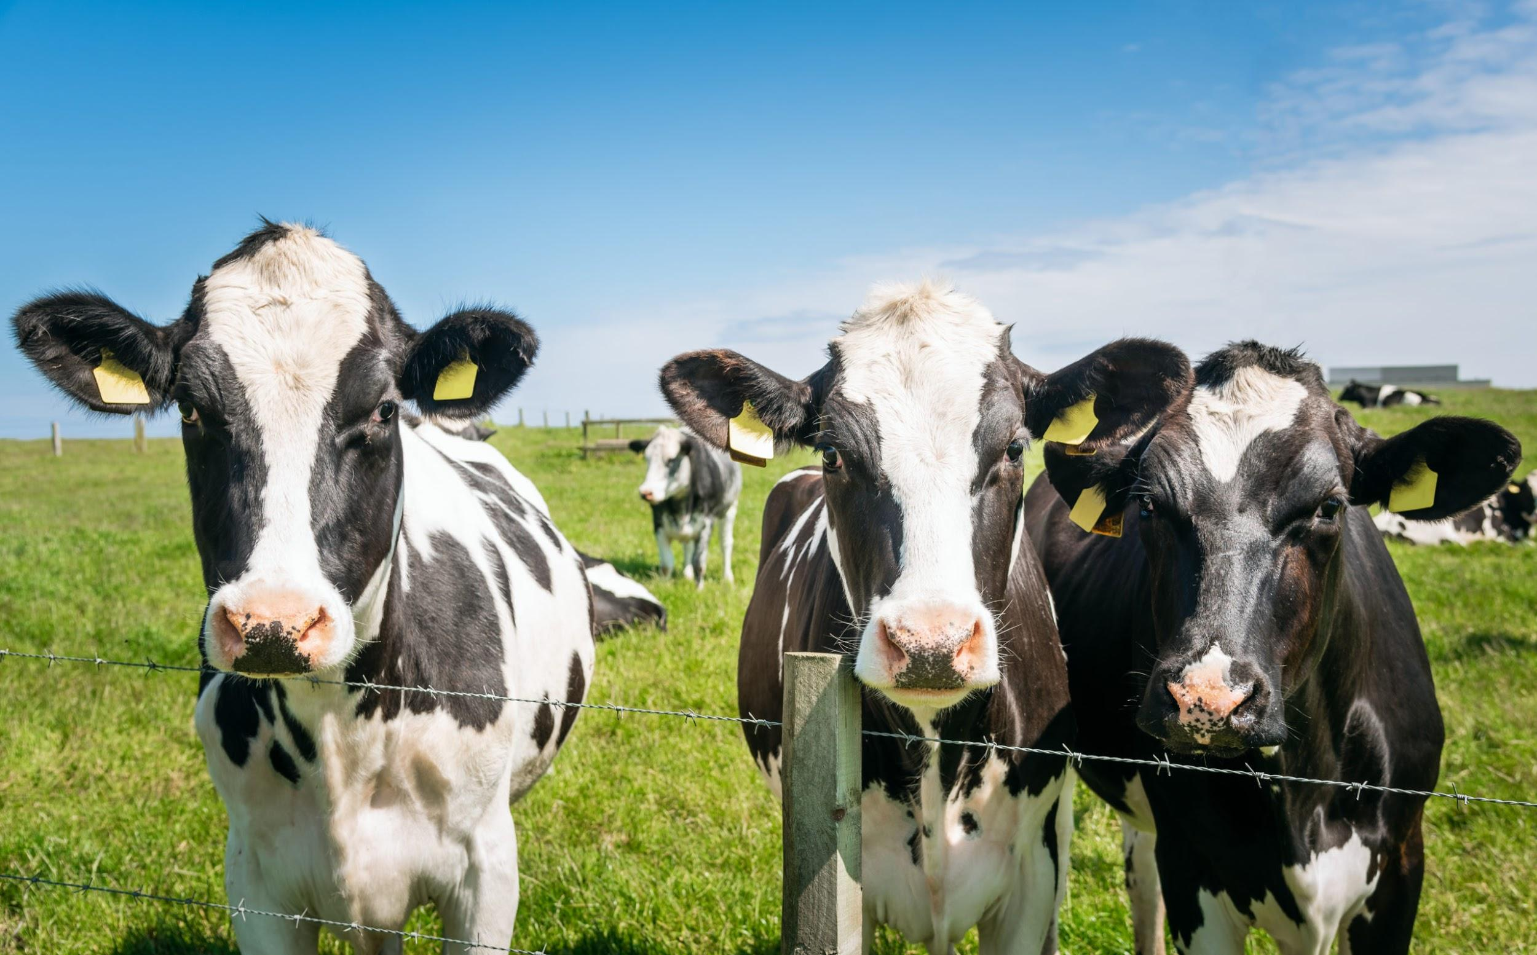
CLUSTERING RESULTS AND COVARIATES OF COWS
Interested to find whether the covariates of the cow relate to the optimal clustering solution
Rand Index and adjusted Rand index
Clustering Solution | Breed | Date of Sampling | Parity | Milking Time
Rand Index | 0.5 | 0.51 | 0.5 | 0.51
Adjusted Rand Index | 0.007 | 0.02 | -0.002 | 0.03

Slide 19
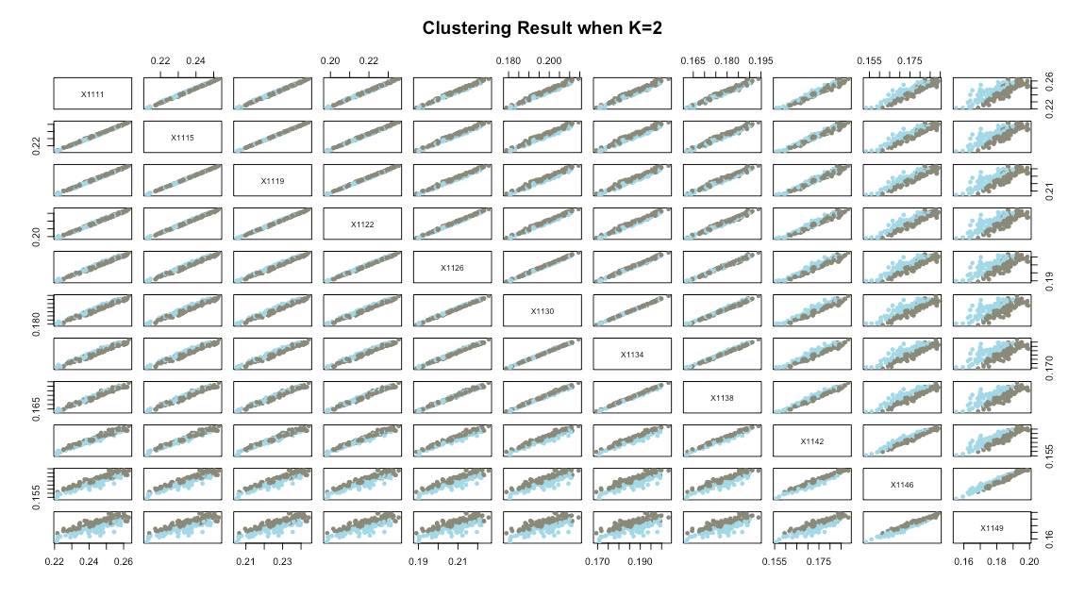
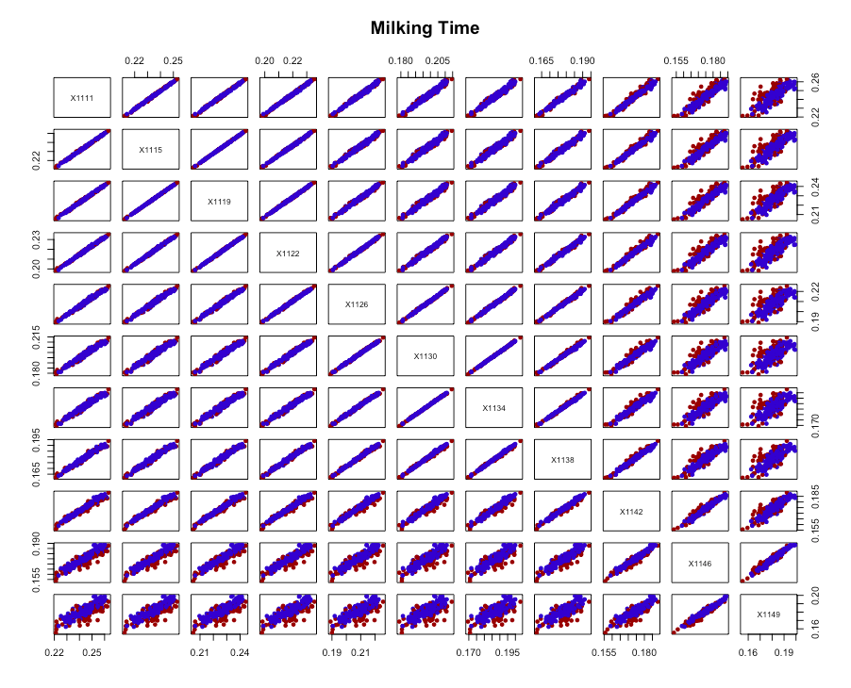
CLUSTERING RESULTS AND COVARIATES OF COWS

Slide 20
Section 3: Classification

Slide 21
K-NEAREST NEIGHBOUR CLASSIFICATION
Interested to classify future milk samples with heat stability of less than 10 minutes (heat stability becomes a factor instead of a numeric variable)
Aim: to predict whether a new milk sample has a heat stability of less than 10 minutes or not
K-Nearest Neighbour Classification
Based on finding k closest points to observation of interest
Labelled the same as the majority of those k points
Limitation: produce different results every time the algorithm is ran -> run it 3 times
Misclassification rates - measures accuracy of classification procedure
Aim: minimise misclassification rate
Training and Test data: 87.5% and 12.5%
Training and Test data: 75% and 25% (not included in the presentation)
Cross validation data
Notes:
What is classification?
Which method? Why not LDA and QDA?
K-nearest neighbour classification: what is it?

Slide 22
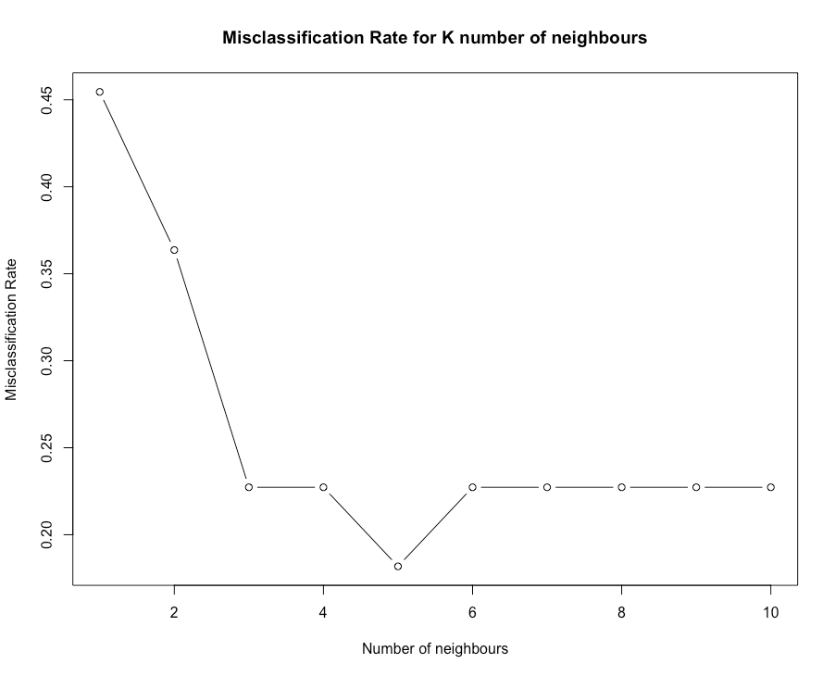

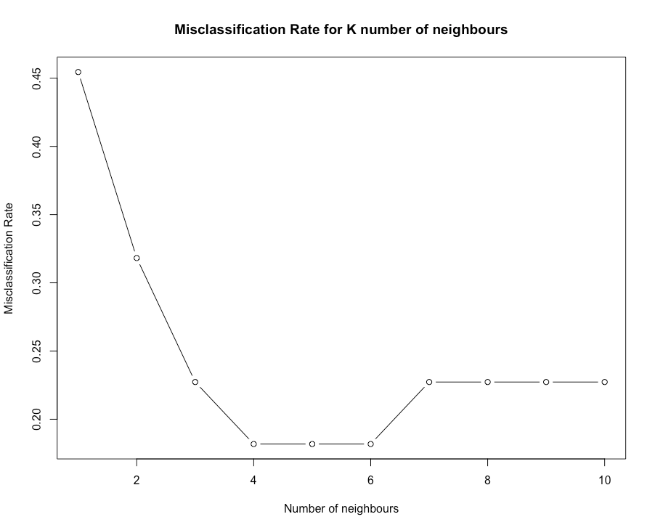
TRAINING AND TEST DATA: 87.5% & 12.5%
Round 1
Round 2
Round 3
Three runs of the algorithm showed the optimal number of neighbours is 5, approximately 18% misclassification rate

Slide 23
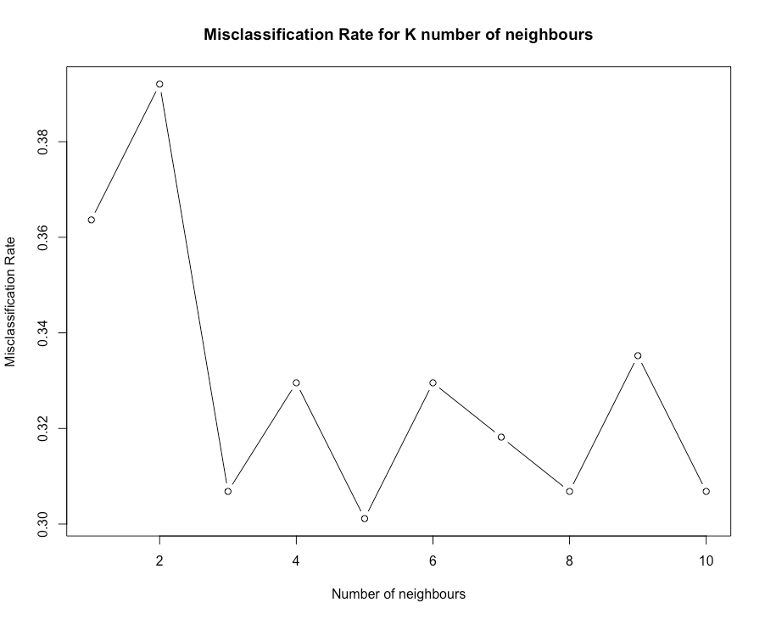
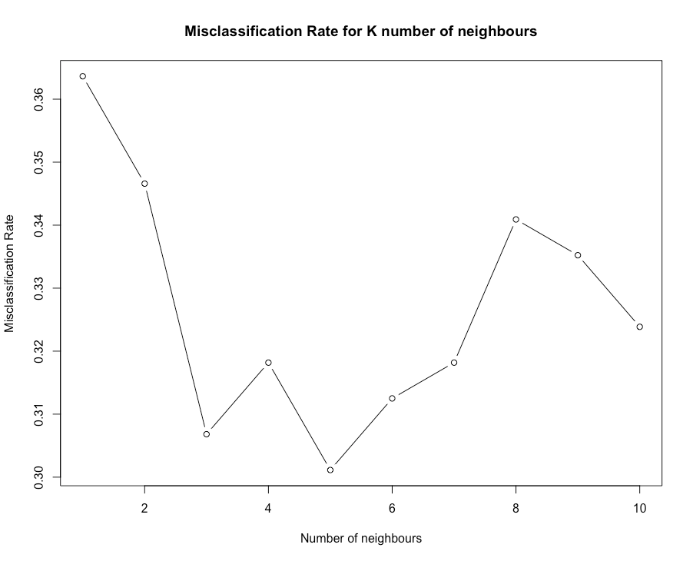
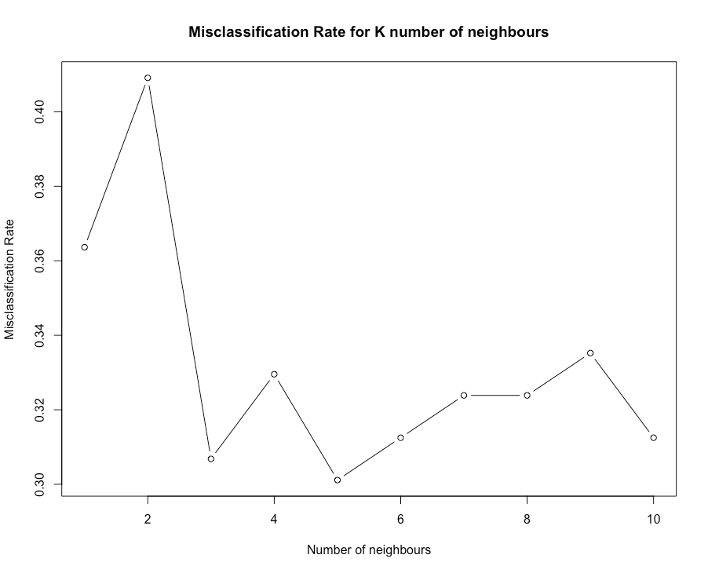
CROSS VALIDATION DATA
Round 1
Round 2
Round 3
Three runs of the algorithm showed the optimal number of neighbours is 5, approximately 30% misclassification rate
Conclusion : 5 is the optimal number of neighbours

Slide 24
THANK YOU FOR LISTENING!!!

Slide 25
REFERENCES
Bittante, G. (2021). Modeling rennet coagulation time and curd firmness of milk. American Dairy Science Association, 94(12), 5821-5831. Retrieved from https://www.journalofdairyscience.org/action/showPdf?pii=S0022-0302%2811%2900617-5
University of Guelph. n.d. Enzymic Coagulation of Milk. [online] Available at: <https://www.uoguelph.ca/foodscience/book-page/enzymic-coagulation-milk> [Accessed 28 February 2021].
Beux, Simone, Pereira, Edimir Andrade, Cassandro, Martino, Nogueira, Alessandro, & Waszczynskyj, Nina. (2017). Milk coagulation properties and methods of detection. Ciência Rural, 47(10), e20161042. Epub September 12, 2017.https://doi.org/10.1590/0103-8478cr20161042
Bonfatti, V., Cecchinato, A., Gallo, L., Blasco, A., & Carnier, P. (2011). Genetic analysis of detailed milk protein composition and coagulation properties in Simmental cattle. Journal Of Dairy Science, 94(10), 5183-5193. doi: 10.3168/jds.2011-4297

